Slide 2


STMO Project: Interway
Robbe Claeys & Jovana Filipovic 19/06/2024
Notes:
Presentation 19/06 at 13:50-14:10

Slide 3
Problem Context

Slide 4


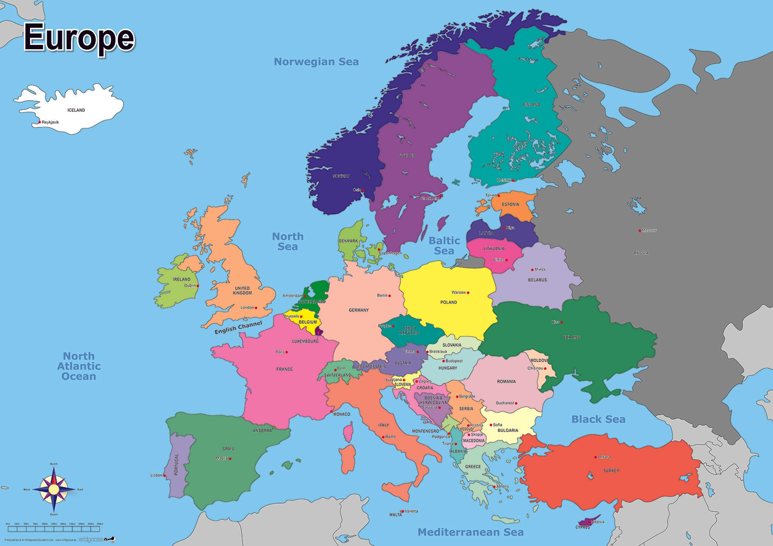


Getting to Serbia
wedding
18/07
Notes:
We want to go on vacation together but … we also need to get to Serbia for a wedding
And so we decided that we should combine both these objectives by traveling by train to Serbia – but stopping in several cities throughout Europe

Slide 5
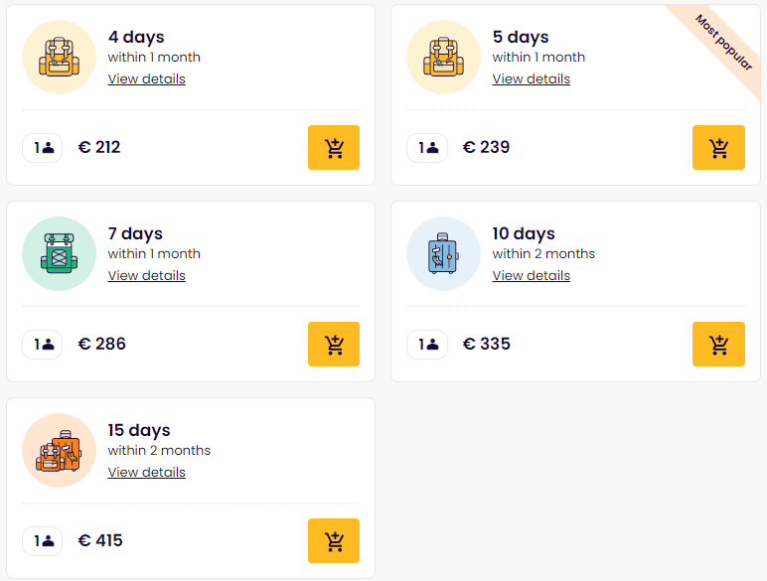
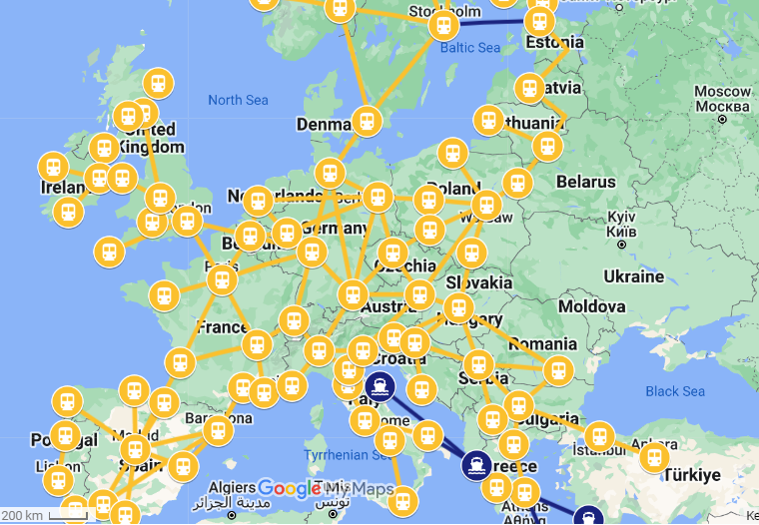

Interrail: Unlimited EU train travel
How many traveldays?
Where should we stop?
How long should we stay at each destination?
So many questions?!?!
Notes:
Which brings us to Interrail. This is a service that allows you to take any train in Europe with 1 interrail pass
These passes are accepted in 33 European countries
You can choose between several different types of passes: x travel-days to spend within one or two months (note only 4, 5, 7, 10, 15-day options are available)
But this left us with many questions to ponder such as
How many travel-days should we choose?
Which cities do we want to visit?
How long should we stay for in those cities?
To deal with this uncertainty, and to be assured we make the optimal travel plans, we decided to formalize our problem and mathematically optimize our vacation!

Slide 6
Problem Definition

Slide 7
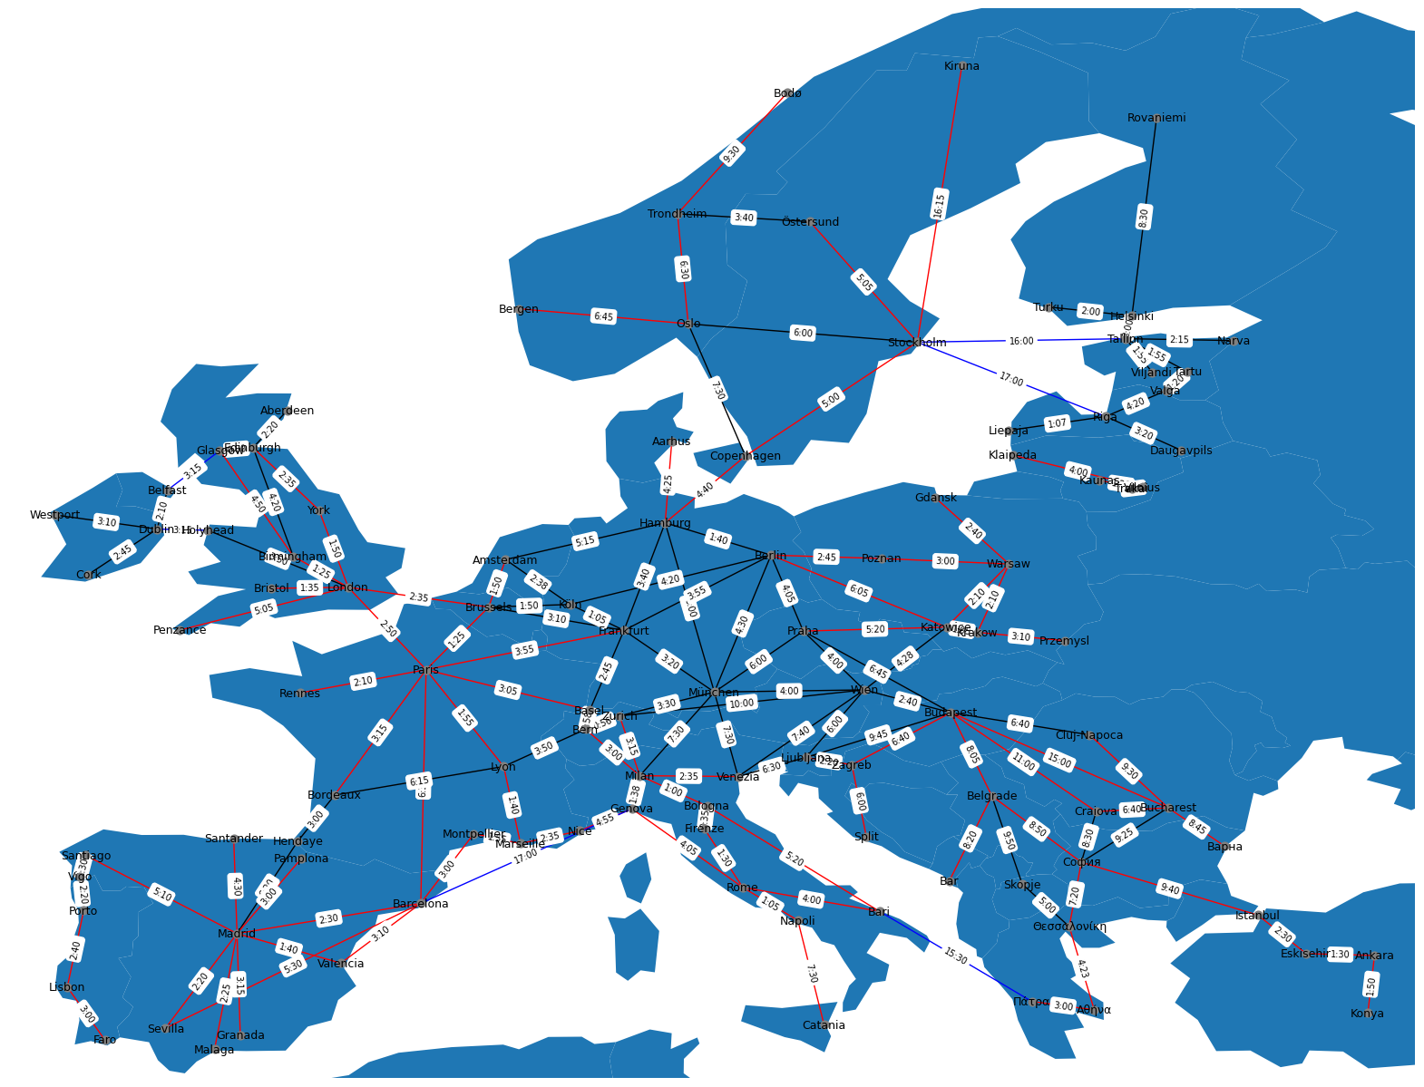
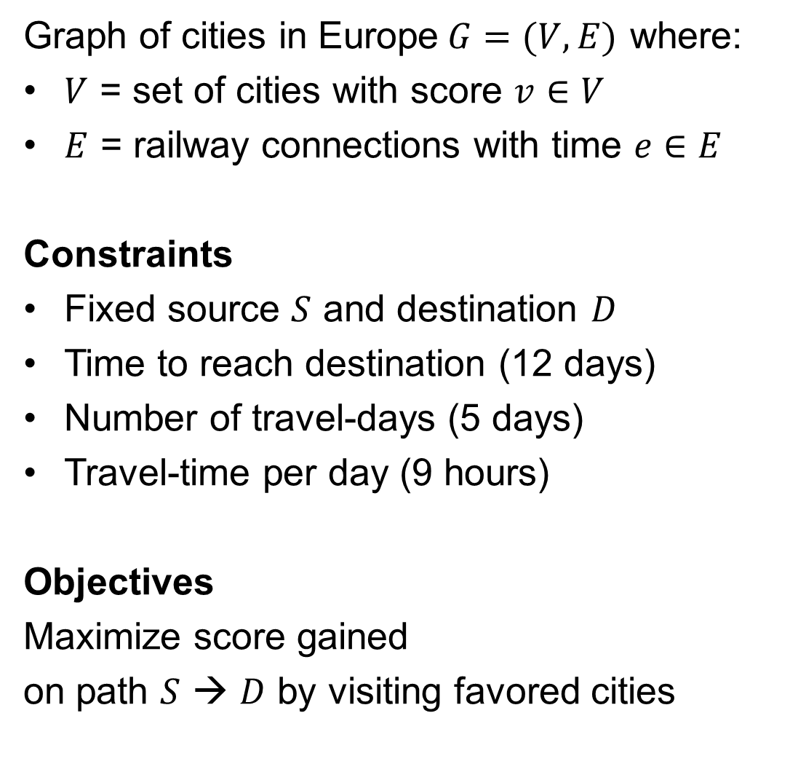
InterWay: a graph problem
Graph of cities in Europe$G=(V,E)$ where:
$V$ = set of cities with score $v∈V$
$E$ = railway connections with time $e∈E$
Constraints
Fixed source $S$ and destination $D$
Time to reach destination (12 days)
Number of travel-days (5 days)
Travel-time per day (9 hours)
Objectives
Maximize score gained on path $S$ → $D$ by visiting favored cities
Multi-constraint!
Notes:
We created a graph of cities in Europe connected through railways and weighted according to travel time
Objectives
t4ret
Constraints
trete

Slide 8


DEMO!
Notes:
python –m http.server --cgi

Slide 9
Approach 1 Brute force search

Slide 10
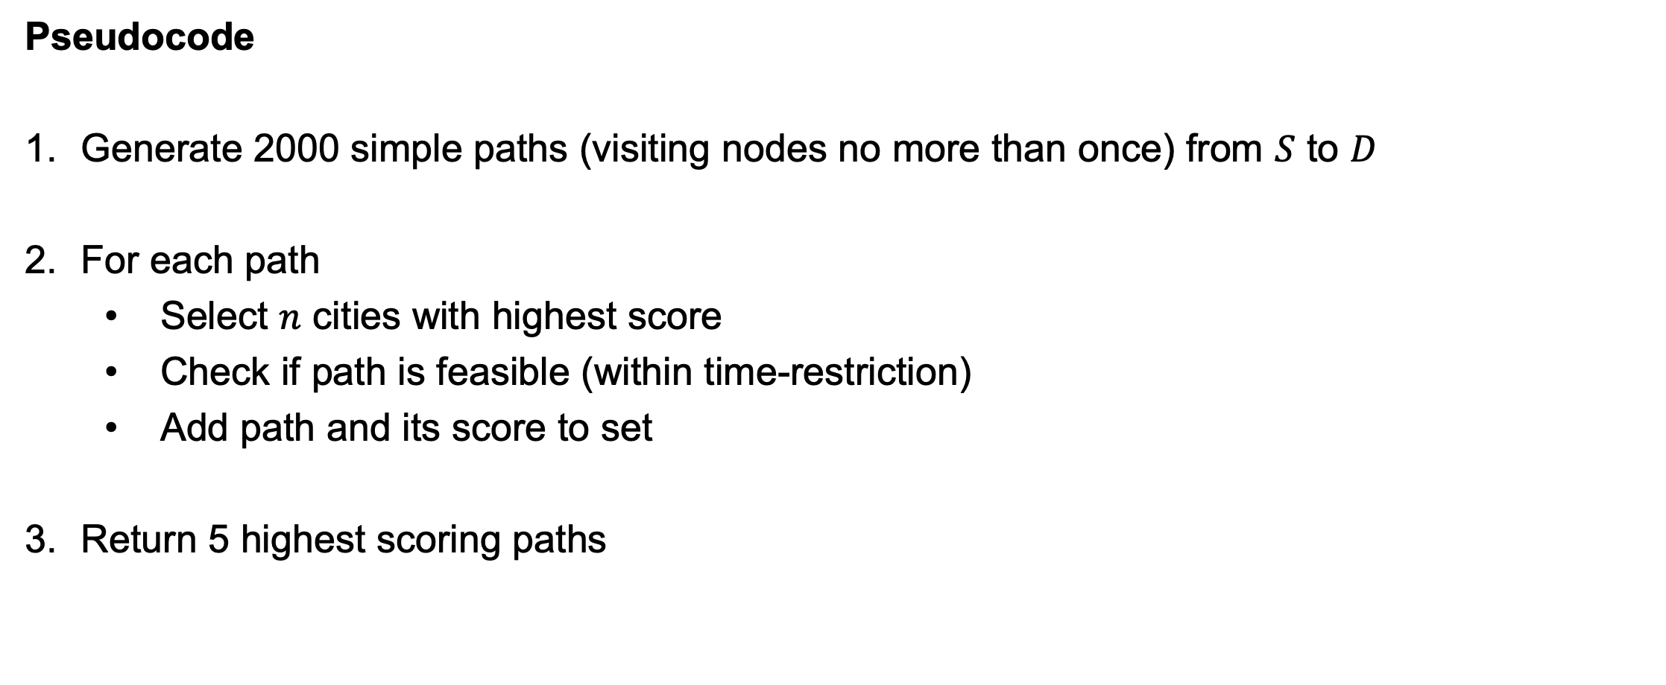
InterWay: the brute force approach
Pseudocode
Generate 2000 simple paths (visiting nodes no more than once) from $S$ to $D$
For each path
Select $n$ cities with highest score
Check if path is feasible (within time-restriction)
Add path and its score to set
Return 5 highest scoring paths

Slide 11
Approach 2 Simulated annealing

Slide 12
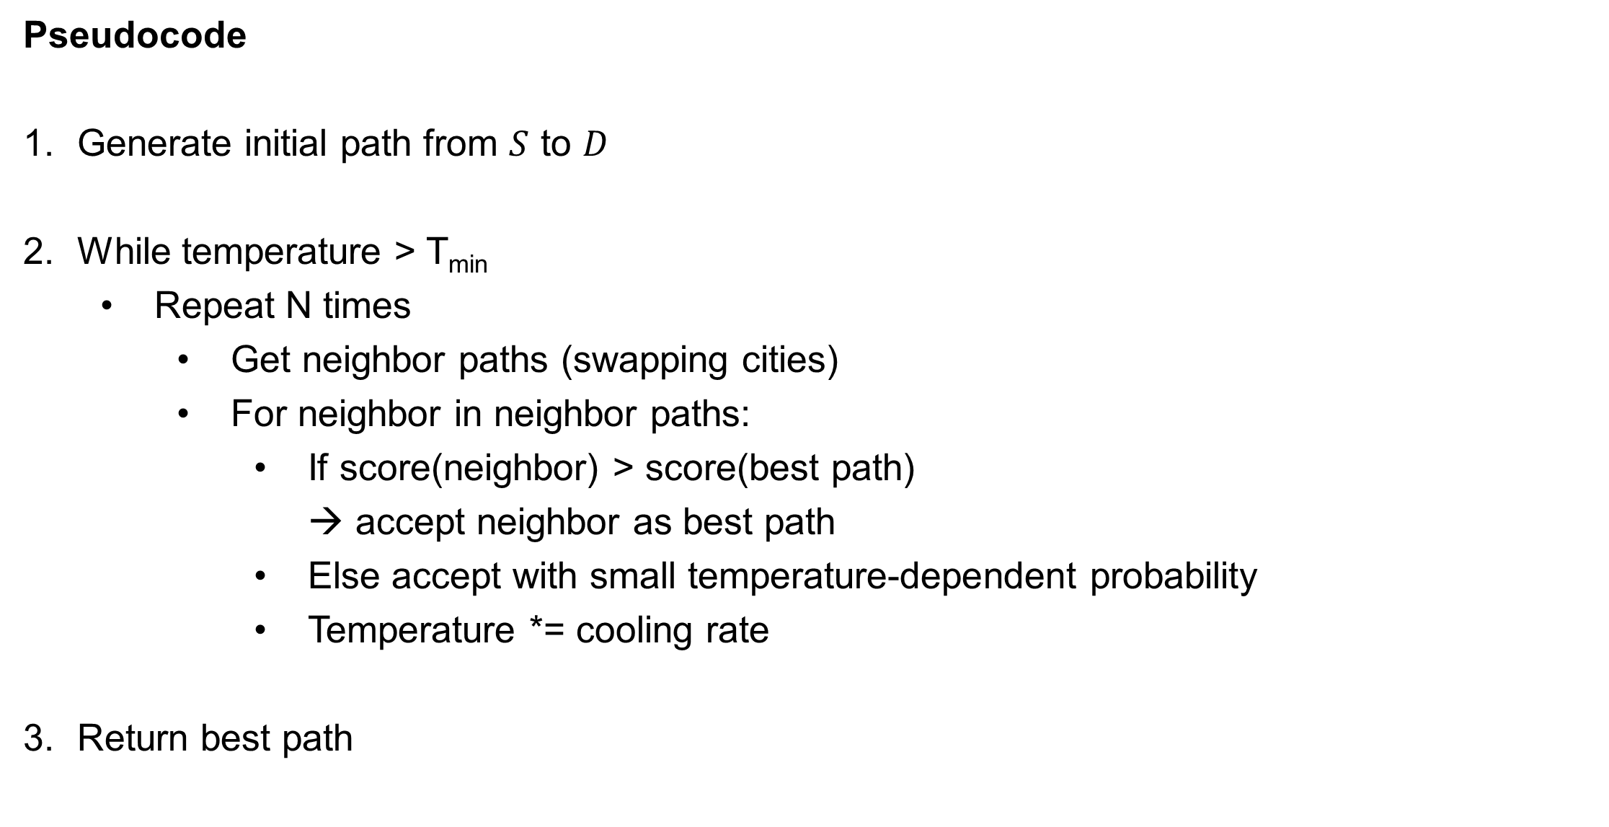
InterWay: the simulated annealing approach
Pseudocode
Generate initial path from $S$ to $D$
While temperature > T_{min}
Repeat N times
Get neighbor paths (swapping cities)
For neighbor in neighbor paths:
If score(neighbor) > score(best path) → accept neighbor as best path
Else accept with small temperature-dependent probability
Temperature *= cooling rate
Return best path

Slide 13
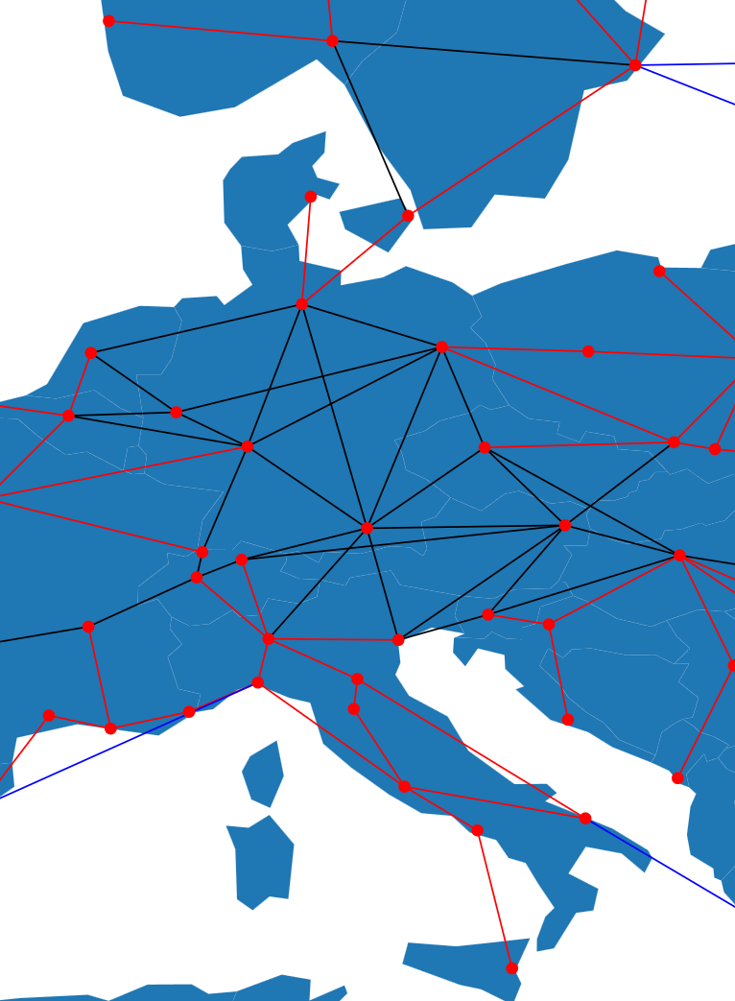
InterWay: the simulated annealing approach
Defining a neighbor path
→ Take one random node in the path and swap that node with all its neighbor nodes
Example
Path = ['Brussels','München','Wien','Budapest','Belgrade’]
Neighbors of path:
['Brussels’, 'Venezia’, 'Wien','Budapest','Belgrade’]
['Brussels’, 'Milan’, 'Wien','Budapest','Belgrade’]
['Brussels’, 'Zurich’, 'Wien','Budapest','Belgrade’]
['Brussels','Frankfurt','Wien','Budapest','Belgrade’]
['Brussels’, 'Berlin’, 'Wien','Budapest','Belgrade’]
['Brussels’, 'Hamburg’, 'Wien','Budapest','Belgrade’]
['Brussels’, 'Praha’, 'Wien','Budapest','Belgrade']

Slide 14


Brute force vs. simulated annealing
Checks many options
Slow
Inefficient (repeats)
Hacky
Fast
More ‘sound’ approach
Local optima
Returns non-existing paths (filtered)

Slide 15




A note on our objective function
Score
Not smooth ☹
Score = 0

Slide 16
A note on our objective function
Score
Immense search space
but only few feasible solutions
BF
SA
Score = 0

Slide 17



Robbe Claeys & Jovana Filipovic www.ugent.be
Universiteit Gent @ugent
@ugent Ghent University

